Slide 1
Let us now investigate…
Two-Player Games

Slide 2
Two-Player Games with Complete Trees
We can use search algorithms to write “intelligent” programs that play games against a human opponent.
Just consider this extremely simple (and not very exciting) game:
At the beginning of the game, there are seven coins
on a table.
Player 1 makes the first move, then player 2, then
player 1 again, and so on.
One move consists of removing 1, 2, or 3 coins.
The player who removes all remaining coins wins.

Slide 3
Two-Player Games with Complete Trees
Let us assume that the computer has the first move. Then, the game can be described as a series of decisions, where the first decision is made by the computer, the second one by the human, the third one by the computer, and so on, until all coins are gone.
The computer wants to make decisions that guarantee its victory (in this simple game).
The underlying assumption is that the human always finds the optimal move.

Slide 4
Two-Player Games with Complete Trees
C
7
1
2
3
H
6
5
4
1
2
1
1
2
3
C
5
4
4
3
2
1
1
1
2
3
1
2
3
3
2
1
H
4
3
2
1
3
2
1
C
C
C
1
2
3
3
2
1
3
2
1
C
3
2
1
H
H
H
H
H
H
3
2
1
H
C
C
C

Slide 5
Two-Player Games with Complete Trees
So the computer will start the game by taking three coins and is guaranteed to win the game.
The most practical way of implementing such an algorithm is the Minimax procedure:
Call the two players MIN and MAX.
Mark each leaf of the search tree with 0, if it
shows a victory of MIN, and with 1, if it shows a
victory of MAX.
Propagate these values up the tree using the rules:
  If the parent state is a MAX node, give it the maximum value among its children.
  If the parent state is a MIN node, give it the minimum value among its children.

Slide 6
Two-Player Games with Complete Trees
C
(min)
7
0
H
(max)
6
5
4
1
1
0
C
(min)
5
4
4
3
2
1
0
1
1
0
0
0
H
4
3
2
1
3
2
1
C
C
C
(max)
0
0
0
0
1
1
1
1
1
1
C
3
2
1
H
1
H
1
H
1
H
1
H
1
H
(min)
1
0
0
0
H
C
0
C
0
C
(max)
0

Slide 7
Two-Player Games with Complete Trees
The previous example shows how we can use the Minimax procedure to determine the computer’s best move.
It also shows how we can apply depth-first search and a variant of backtracking to prune the search tree.
Before we formalize the idea for pruning, let us move on to more interesting games.
For such games, it is impossible to check every possible sequence of moves. The computer player then only looks ahead a certain number of moves and estimates the chance of winning after each possible sequence.

Slide 8
Two-Player Games
Therefore, we need to define a static evaluation function e(p) that tells the computer how favorable the current game position p is from its perspective.
In other words, e(p) will assume large values if a position is likely to result in a win for the computer, and low values if it predicts its defeat.
In any given situation, the computer will make a move that guarantees a maximum value for e(p) after a certain number of moves.
For this purpose, we can use the Minimax procedure with a specific maximum search depth (ply-depth k for k moves of each player).

Slide 9
Two-Player Games
For example, let us consider Tic-Tac-Toe (although it would still be possible to search the complete game tree for this game).
What would be a suitable evaluation function for this game?
We could use the number of lines that are still open for the computer (X) minus the ones that are still open for its opponent (O).

Slide 10
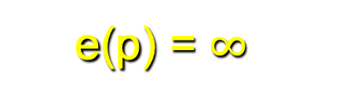
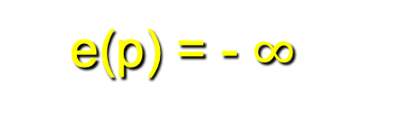
Two-Player Games
X
O | X
O | O | X
X | O
X
e(p) = 8 – 8 = 0
e(p) = 6 – 2 = 4
e(p) = 2 – 2 = 0
shows the weak-ness of this e(p)
How about these?
O | O | X
 | X
X
X | X
O | O | O
 | X

